Slide 1
Migration to tus.ie – Staff Information Session
Thursday May 18th 2023

Slide 2
Housekeeping
Presentation approx. 40 mins
Q&A available throughout – enter all questions through the Q&A (regular Chat is disabled)
Recording will be made available after presentation
Referenced links available in Q&A

Slide 3
Agenda
Migration Overview
What is being migrated
What is NOT being migrated
Access to your tus.ie accounts
Access to Apps and Services
What to expect on May 29th
Accessing your device
Accessing your Office apps
Support
Q&A
Notes:
We will go through the following today – we’ll keep it as brief as possible while providing the information you will need to access your accounts on and after May 29th

Slide 4
Migration Overview

Slide 5
Support - Migration FAQs
TUS Midwest Helpdesk – accessible to all TUS staff: https://helpdesk.lit.ie/support/solutions/articles/27000078682-staff-account-migration-to-the-new-tus-ie-environment-tus-systems-integration-faq
ICT Systems Integration website - https://tus.ie/systems-integration
Helpdesk and Desktop Support will be providing migration support at the helpdesk
Walk-up service in Moylish and Athlone
Technical support available as normal on other campuses
Log a call if required

Slide 6
What if I’m not onsite on May 29th?
You can access your @tus.ie E-mail, OneDrive and other Office 365 apps via the web browser
You can add the accounts to your existing Outlook and OneDrive apps on your device
You will have to sign out of Teams and log in with your tus.ie e-mail address
Your device will not be migrated on May 29th if you are not on site – you must bring it onsite when available and connect to the network.
Please notify the helpdesk when you will be available onsite to carry out your migration, they can then assist you if required
If you do not have a TUS device, you can access your @tus.ie account via web browser, or by adding it as a new account to your MS Outlook or other e-mail application.

Slide 7
What is being migrated?
E-mail
OneDrive
Teams
OneNote (as part of OneDrive)
Notes:
E-mail, OneDrive and Teams data
Only Teams active since October 22 – if there is data in older Teams that yo need then you’ll have to logon to your old account to retrieve it.

Slide 8
What is NOT being migrated
MS Forms
Yammer
PowerBI
MS Planner
Notes:
See the FAQ for details if you need to migrate this type of data.

Slide 9
Tus.ie username and password
Your tus.ie username is in the format <firstname.lastname>@tus.ie
E.g. joe.bloggs@tus.ie
If you have been advised that your @tus.ie e-mail address is not exactly <firstname>.<lastname>@TUS.ie – that is, if you have your middle initial as part of your tus.ie e-mail address - e.g. if your tus.ie mail address is johnb.smith@tus.ie - then johnb.smith@tus.ie will be your new logon name
Notes:
The @tus.ie address that you currently use as your address rewrite mail – that is, the e-mail address external users see when you send a mail to them from your AIT or LIT e-mail – is the e-mail you will have

Slide 10
Mail sent to your old AIT or LIT e-mail addresses
All e-mail from your old ait.ie or lit.ie mailbox will be migrated to your tus.ie mailbox
Mail sent to your AIT or LIT addresses will be forwarded to your new TUS e-mail after migration – so if someone sends you an e-mail to your old @ait.ie or @lit.ie address after the changeover, you will receive it in your @tus.ie mailbox
Your old mailbox will be restricted to only allow mail to be sent to tus.ie addresses after the migration
If you do not have a TUS device, you can access your @tus.ie account via web browser, or by adding it as a new account to your MS Outlook or other e-mail application on your personal device.

Slide 11
Shared/departmental e-mails
An exercise was carried out with all departments to identify departmental mailboxes that need migration to TUS
Shared and departmental e-mail addresses will become shared mailboxes in TUS
Generic departmental user accounts will also become shared mailboxes – rather than logging in to a separate account, it will now be available to relevant users as a shared mailbox in their Outlook.
Users will have rights assigned to these mailboxes as required
The mailbox will then be accessible in the Outlook desktop app and via Outlook for Web
Mailboxes that exist with the same name in both tenants, that both need to be migrated, will have a .midlands and .midwest applied to the address. So newfrontiers@lit.ie will become newfrontiers.midwest@tus.ie, and newfrontiers@ait.ie will become newfrontiers.midlands@tus.ie

Slide 12
Access to your TUS device and accounts

Slide 13
Logging on to your TUS device
@tus.ie
Notes:
Firtname.lastname
Note that you will sign in to TUSSTAFF
If your device hasn’t been migrated you can still login with your existing username and password.

Slide 14
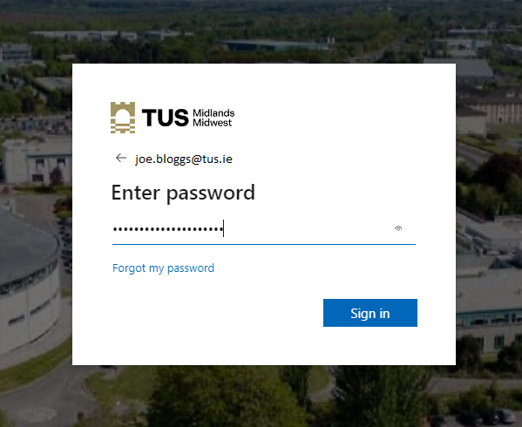
Logging in to your tus.ie Office 365 account (E-mail) https://login.microsoftonline.com

Slide 15
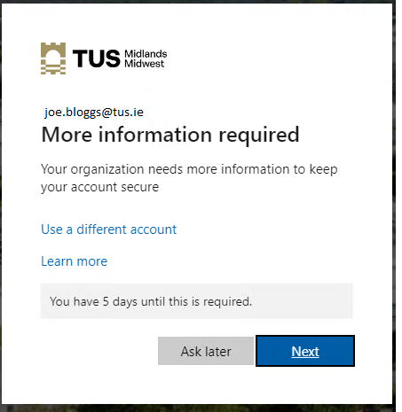
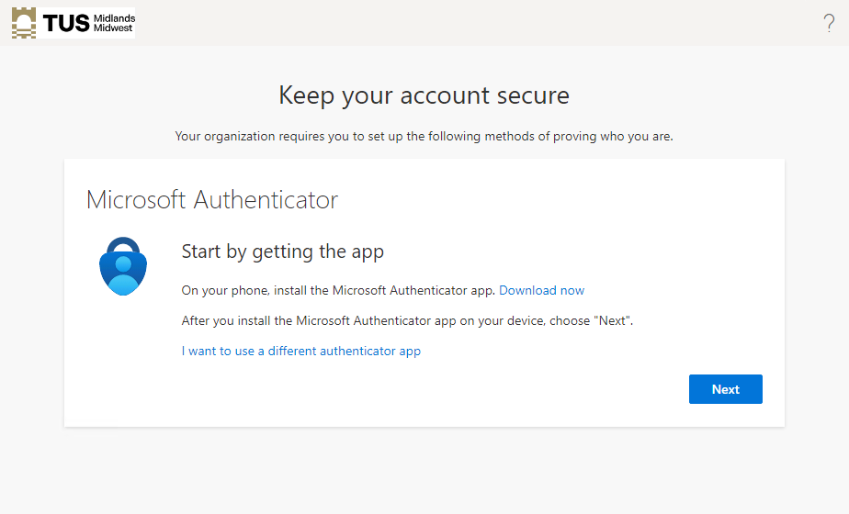
Multifactor Authentication
You will be asked to set up MFA at this point
Notes:
Click Next

Slide 16
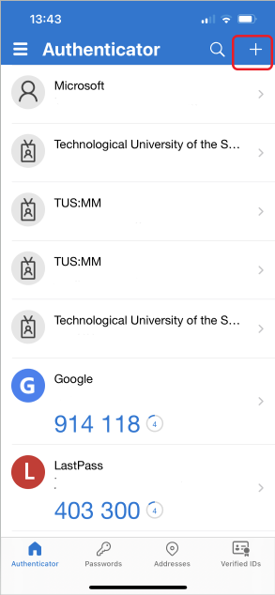
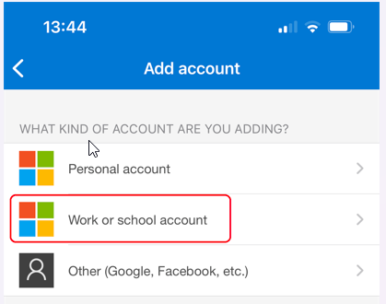
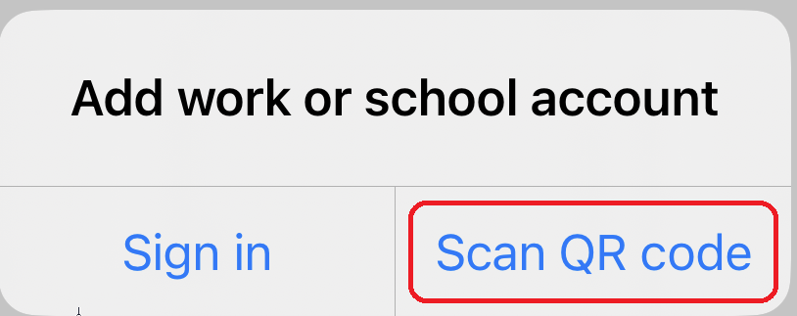
Multifactor Authentication

Slide 17
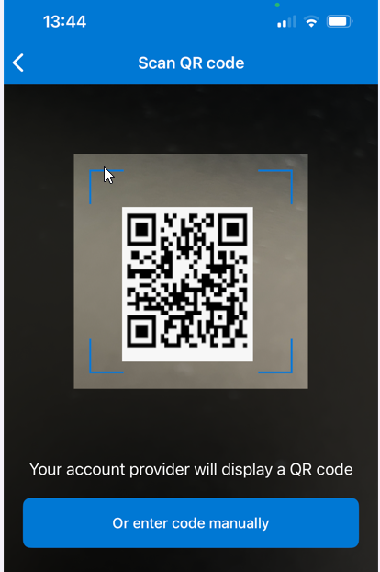
Multifactor Authentication

Slide 18
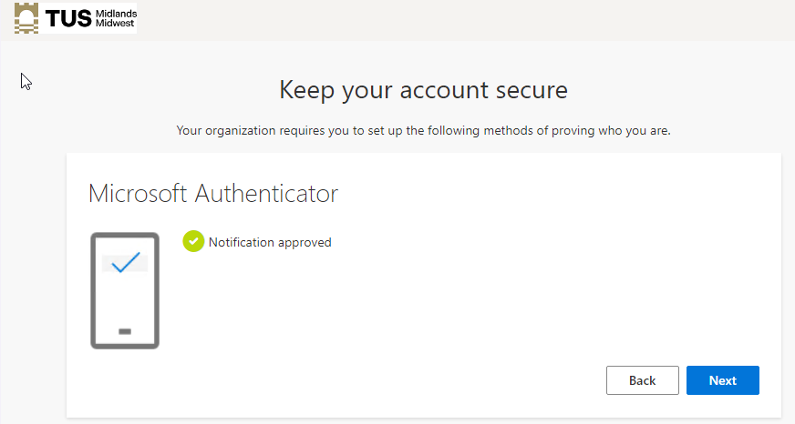
Multifactor Authentication

Slide 19
Multifactor Authentication

Slide 20
Access to TUS apps and services

Slide 21
Access to Apps and Services
Many apps and services require login via your current Office 365 username and password
These will be migrated to use your tus.ie username and password.
Includes CoreHR/Access (HR and Payroll details), Agresso/Unit4 (finance systems), Banner (student records), etc
Many will be accessible using your tus.ie password from May 29th but others will have to be accessed using your current AIT/LIT username and password for a time after migration
A list will be available on the systems integration website detailing what credentials you need to use
Access to the tus.ie apps will be via My Apps at https://myapplications.microsoft.com – this will be available by default as a tab when you open Microsoft Edge on your TUS device.
You can also access your apps from the office.com default page

Slide 22
Access your apps - myapplications.microsoft.com
https://myapplications.microsoft.com
Notes:
Best place to go – its all there.
This page will be a homepage by default when you launch Edge from your TUS device, assuming it has been migrated.

Slide 23
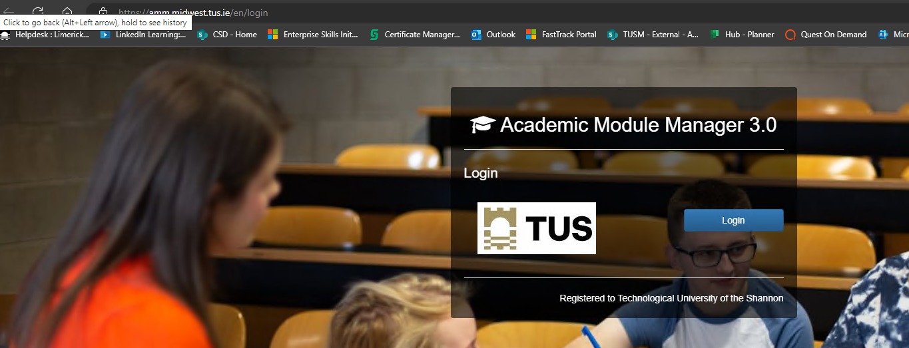
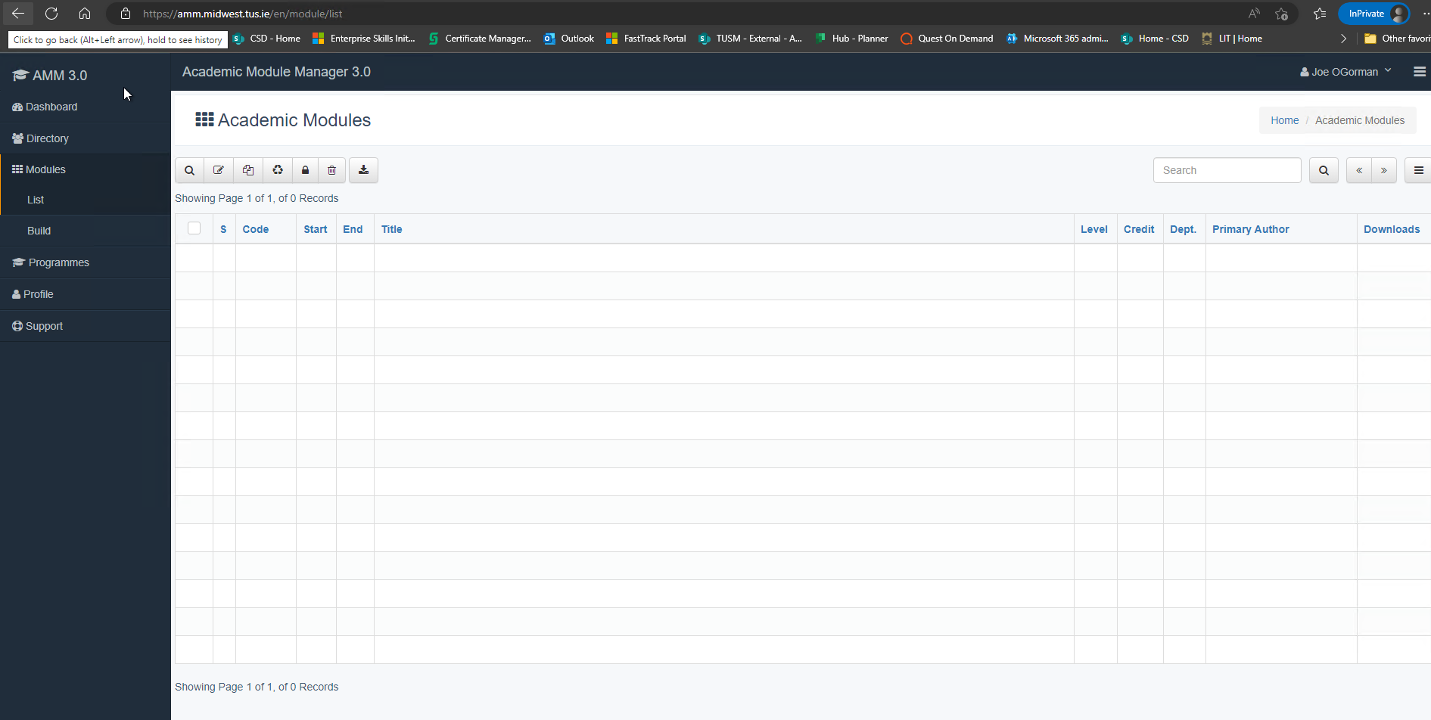
Access your apps – Module Manager (example)

Slide 24
Add more apps to your MyApps

Slide 25
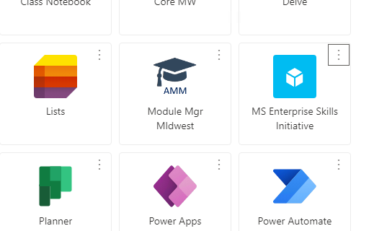
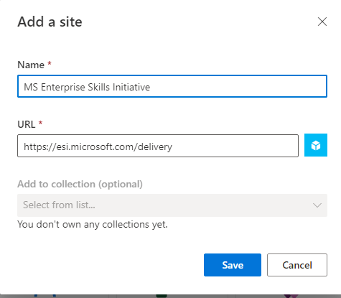
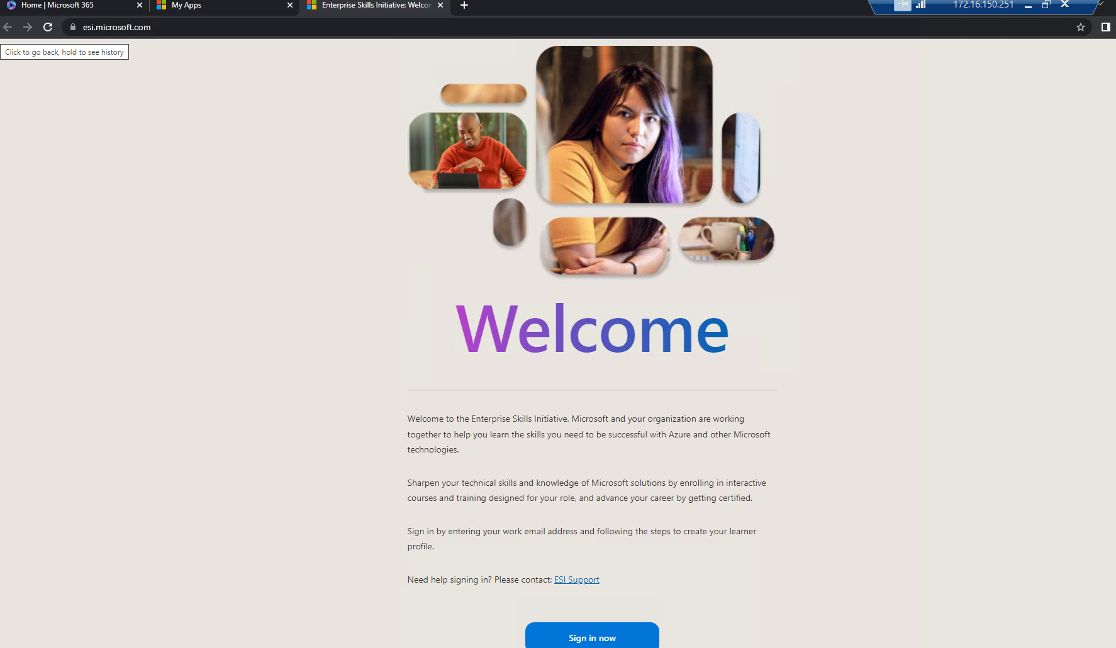
Add more apps to your MyApps

Slide 26
Access your Apps – Office.com

Slide 27
Access your Apps – Office.com

Slide 28
Other Services
Printing – will be moved across over the course of the week from Monday May 29th
Eduroam – WiFi will be available as normal

Slide 29
Accessing apps using your old AIT or LIT account
If you need to access your apps using your old AIT or LIT account, you must use an incognito or private browser and sign in from there
Different ways to do this – see the Systems Integration website FAQ for details

Slide 30
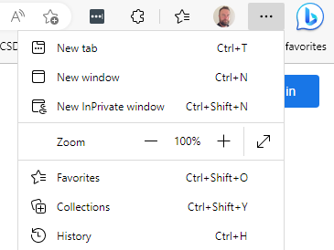
Open an incognito/InPrivate browser – MS Edge
1.
2.

Slide 31
Open an incognito/InPrivate browser – MS Edge

Slide 32
Open an incognito/InPrivate browser – Google Chrome/other browsers
More details on using Incognito/InPrivate browsing:
Google Chrome
Browse in private - Computer - Google Chrome Help
Mozilla Firefox
Private Browsing - Use Firefox without saving history | Firefox Help (mozilla.org)
Apple Safari
Browse privately in Safari on Mac - Apple Support (IE)

Slide 33
What happens on May 29th and beyond?

Slide 34
What happens on May 29th?
If you have left your device on campus, powered on and connected to the network, over the weekend of May 26th - 28th your device should already be migrated to the TUSSTAFF domain for Monday May 29th
If not, you will need to be on campus on May 29th and your device switched on and connected to the wired network, either via your laptop dock or a network cable, if you use a desktop PC.
The migration jobs will be kicking off in the background over the course of the day.
The first part of the migration is the move of the device to the new TUSSTAFF domain
The second part is the configuration of your access to your new TUS.ie Office 365 account for e-mail, OneDrive, Teams, etc.

Slide 35
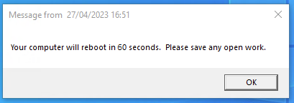
Device Move to TUS
Note that it may take some time for your device to migrate depending on migration load
When the job has finished, you will get a notification to say your device will reboot, and to save your work. Please ensure that you have any work saved as the device reboot will take place 60 seconds after the notification
Not all devices will be suitable for this migration; some will have to be manually moved to the new environment

Slide 36
Logging on to your TUS device
@tus.ie
Notes:
Firtname.lastname
Note that you will sign in to TUSSTAFF
If your device hasn’t been migrated you can still login with your existing username and password.

Slide 37
TUS Desktop

Slide 38
Accessing your @tus.ie accounts
3 methods
Using the Quest On Demand Desktop Update Agent
If your device has been automatically migrated and has the agent installed
Manually entering your account details
If you have had your device migrated by a member of CSD, or the Quest agent is not installed
Adding your account to an existing e-mail client
If your device has not yet been migrated, if you have a personal device, or if your device is not migratable (e.g. an Apple Mac or similar)
Note that you will need to rcreate your e-mail signature in Outlook when you access your new account

Slide 39
Accessing your tus.ie accounts Method 1 - Quest Migration Desktop Update Agent
The migration job will install a tool called On Demand Migration Desktop Update Agent on your device
Not all devices will have this installed; that is OK, you can use one of the other methods that follow.
This will allow you to change your account settings over to your new @tus.ie account all at once for Outlook, OneDrive and Teams
You will have to start the application and run it yourself
Make sure you have closed all your other applications and files before you run this, as you will need to restart the Office applications and sign in with your new username and password as part of this process.

Slide 40
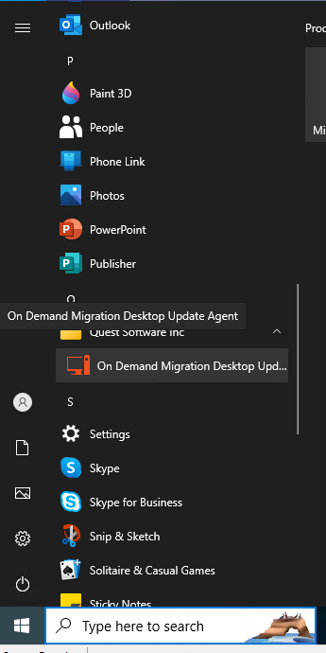
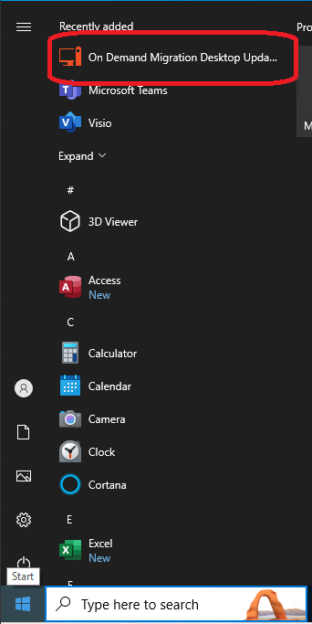
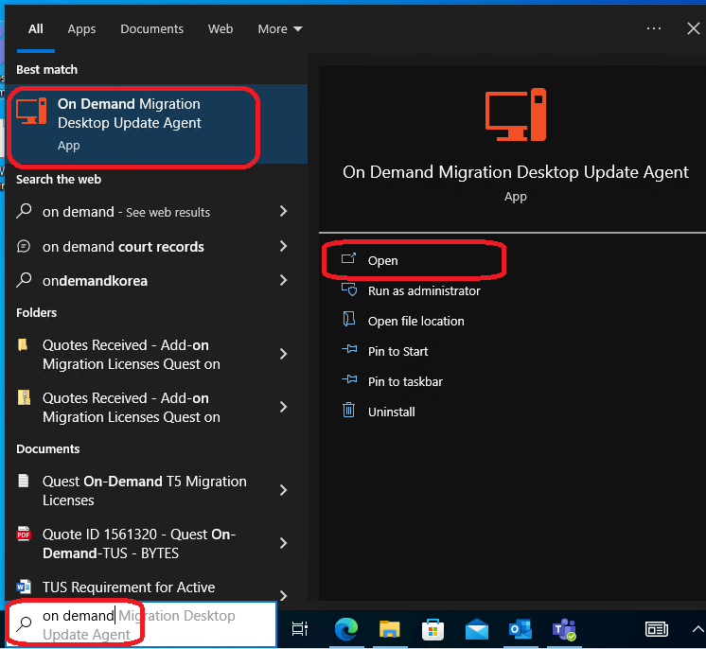
Accessing your tus.ie accounts – Quest Migration Desktop Update Agent
Click on the Windows Start Button; the app may be at the top of the list, if not search for ‘On Demand’ in the search box, and click Open; or search for Quest Software in the program list and then click On Demand Migration Desktop Update Agent

Slide 41
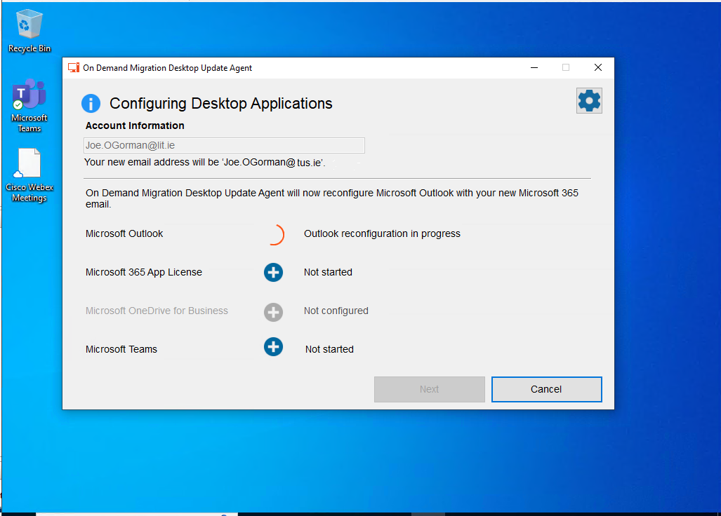
Accessing your tus.ie accounts – Quest Migration Desktop Update Agent

Slide 42
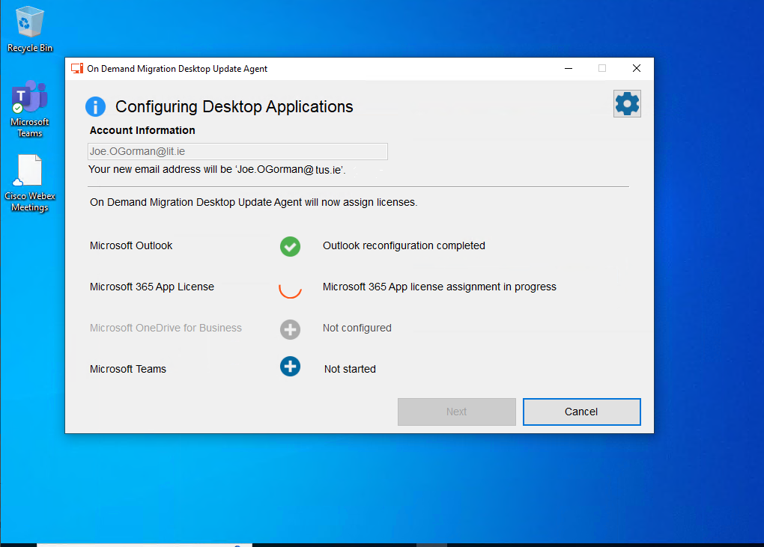
Accessing your tus.ie accounts – Quest Migration Desktop Update Agent
Once the first task has finished, click Next
Notes:
When each stage completes, you will need to click Next to kick off the next stage

Slide 43
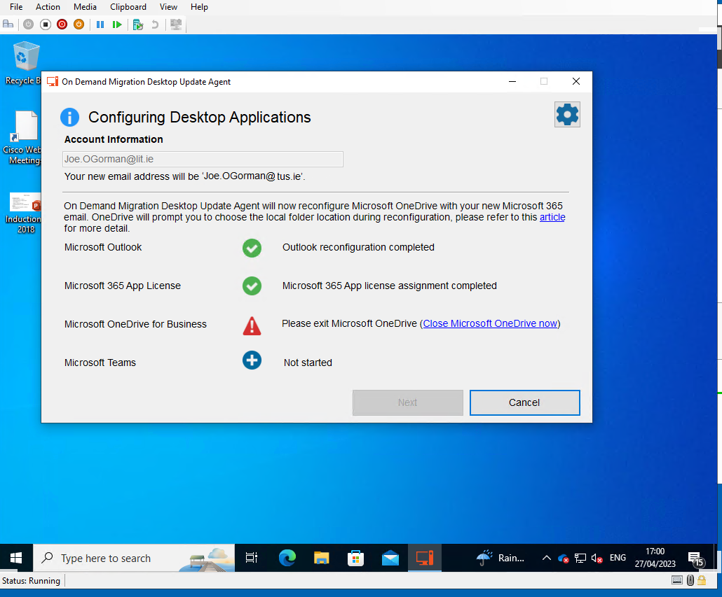
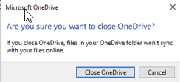
Accessing your tus.ie accounts – Quest Migration Desktop Update Agent
Notes:
You will be asked to close down the office apps if they are running. Click on the link in the On Demand app to close them; if you get a pop up asking are you sure, close that as well.

Slide 44
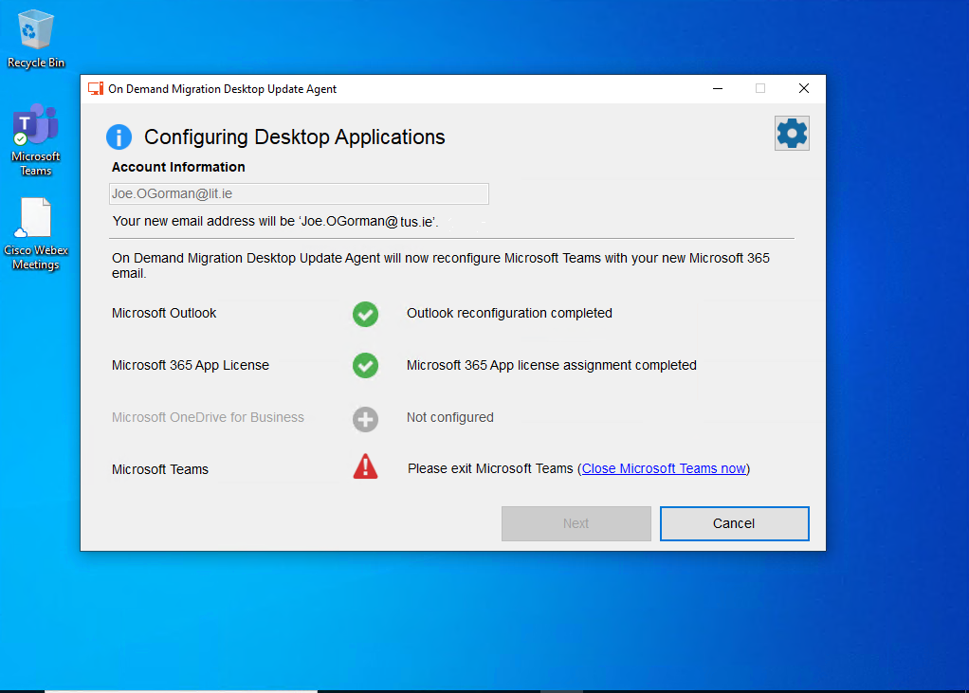
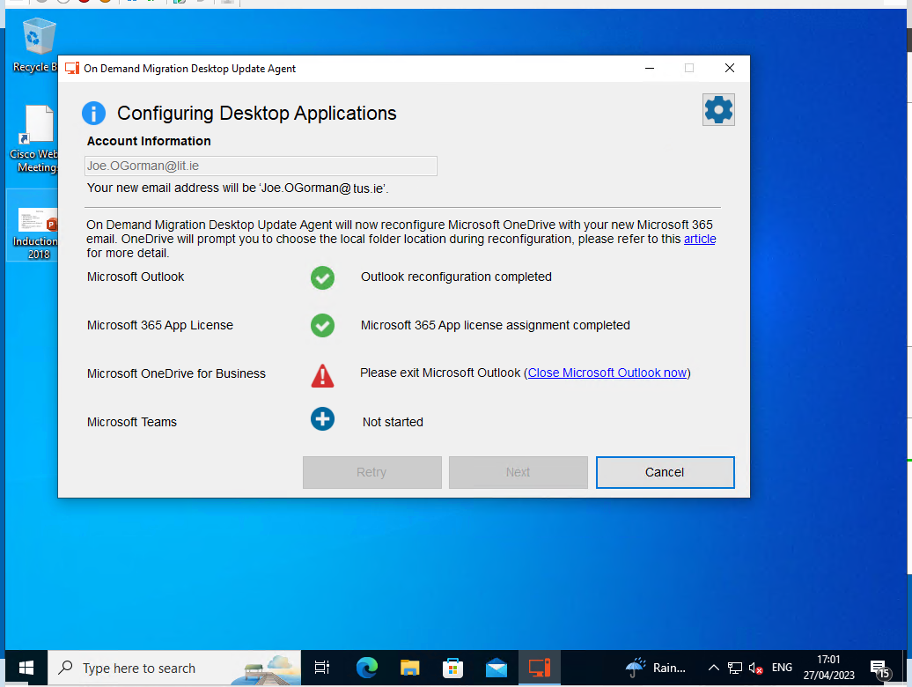
Accessing your tus.ie accounts – Quest Migration Desktop Update Agent
Notes:
You may be asked to close different apps during the configuration phase – for instance, the OneDrive configuration here needed to have Outlook closed. Simply click on the ‘Close MS Outlook Now’ button

Slide 45
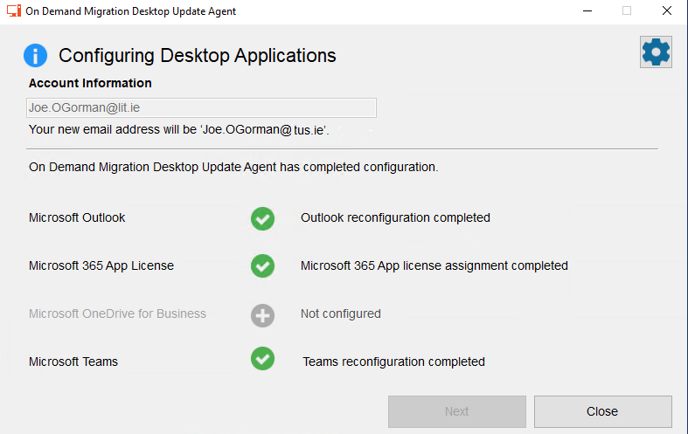
Accessing your tus.ie accounts – Quest Migration Desktop Update Agent

Slide 46
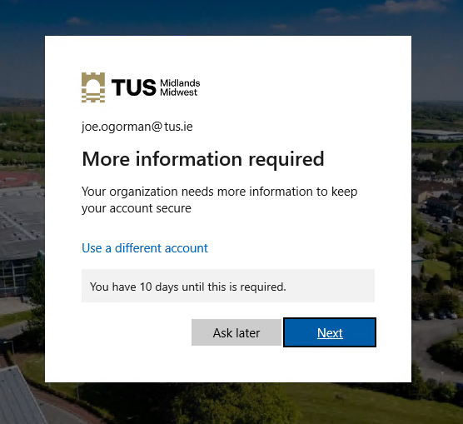
Accessing your tus.ie accounts – Quest Migration Desktop Update Agent
You will have to enter your username and password several times as well
You will get the prompt to set up your MFA every time – it is advisable to do it straight away

Slide 47
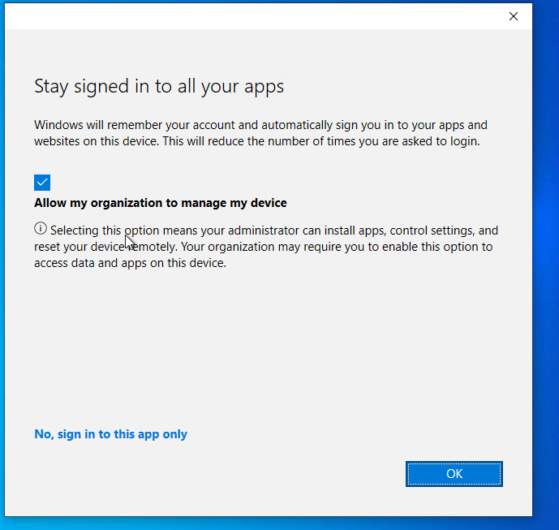
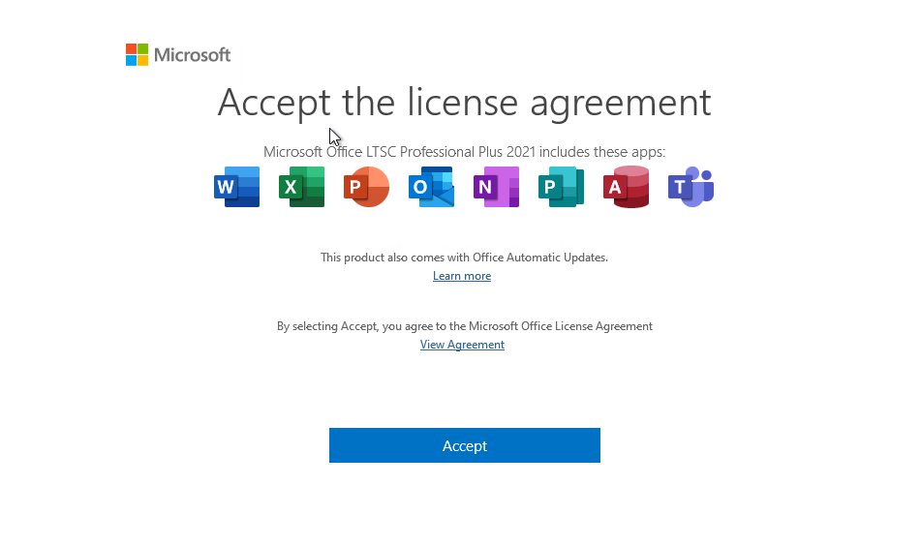
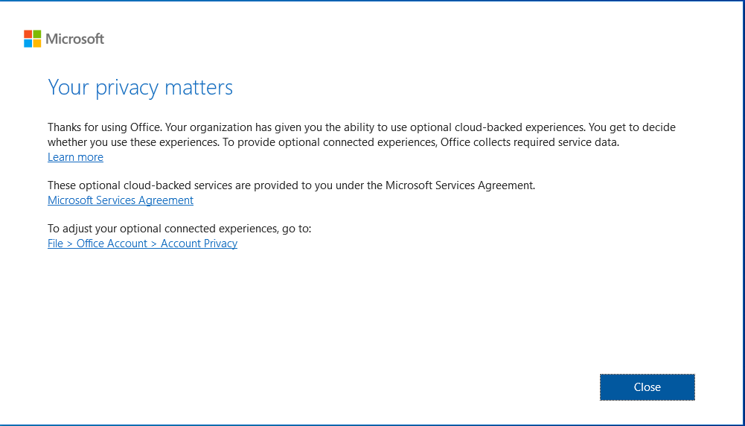
Accessing your tus.ie accounts – Quest Migration Desktop Update Agent
You will get numerous license prompts as the apps restart and reconfigure – click on OK/Close for each one

Slide 48
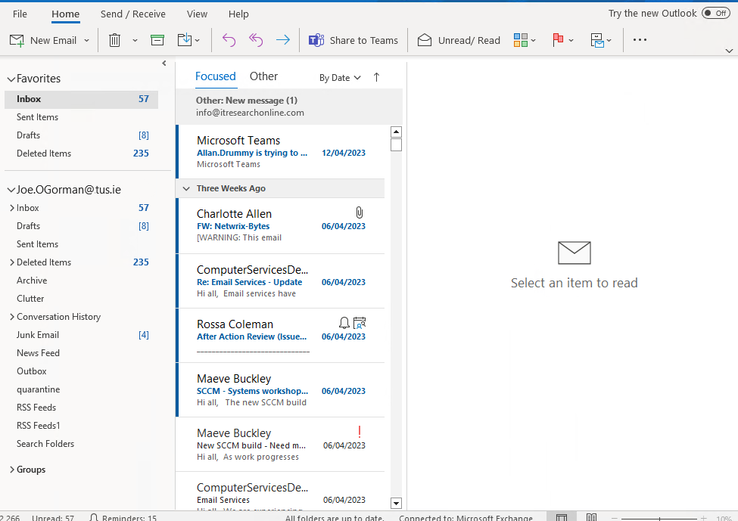
Accessing your tus.ie accounts – Quest Migration Desktop Update Agent

Slide 49
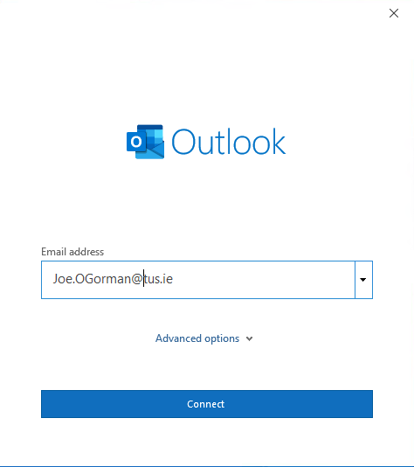
Accessing your tus.ie accounts Method 2 – manually logging in
Open up Outlook and enter your @tus.ie e-mail address when prompted; you will be prompted to set up your MFA at this time if you haven’t already done so

Slide 50
Logging in to E-mail
Click through the various popup screens

Slide 51
Logging in to E-mail

Slide 52
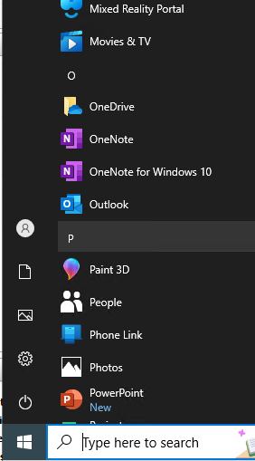
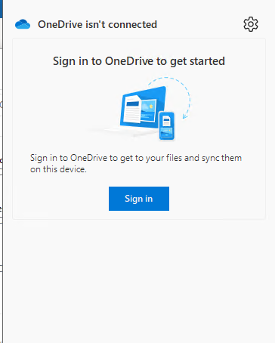
Logging into OneDrive

Slide 53
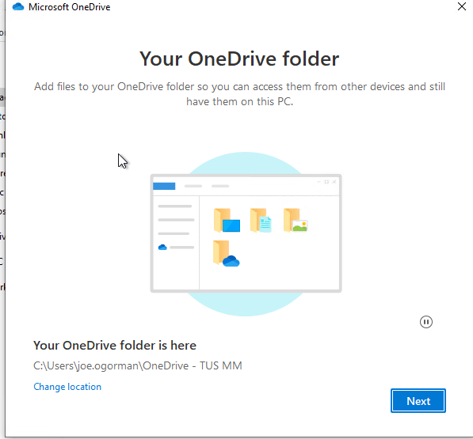
Logging in to OneDrive

Slide 54
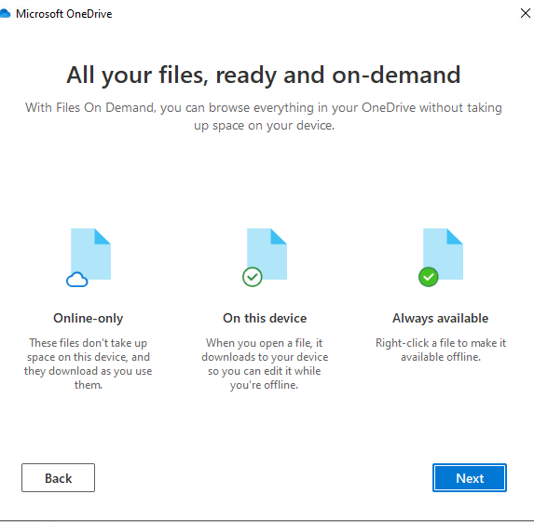
Logging into OneDrive

Slide 55
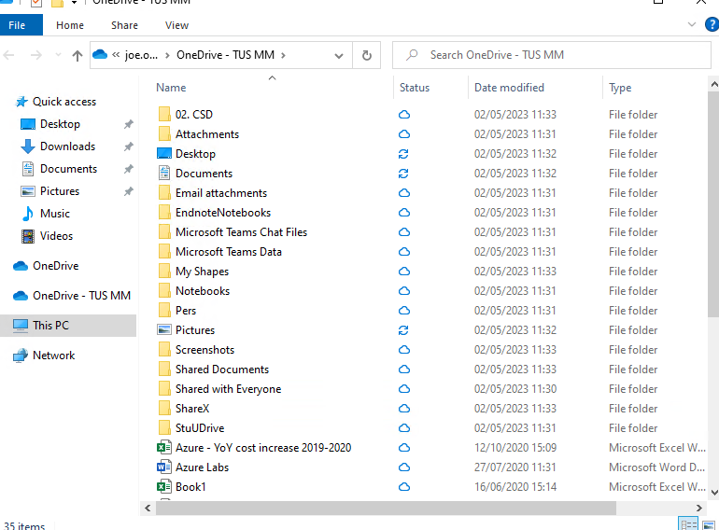
Logging into OneDrive

Slide 56
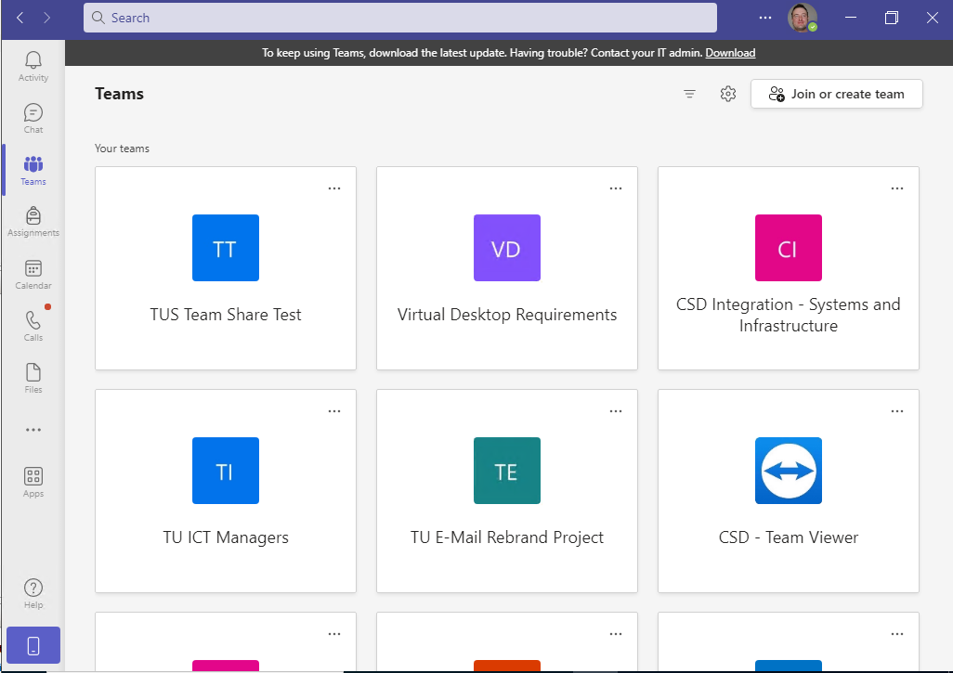
Logging into Teams

Slide 57
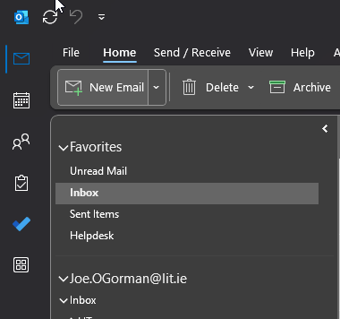
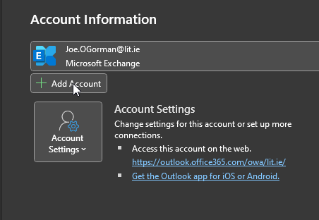
Accessing your tus.ie accounts Method 3 – add your account to your e-mail client
If you do not have a TUS.ie device, or you are unable to come onsite, you can add your new tus.ie account to your existing Outlook or other mail application
Open your Outlook application as normal, and select File from the menu on the top right, then click Add Account under Account Information

Slide 58
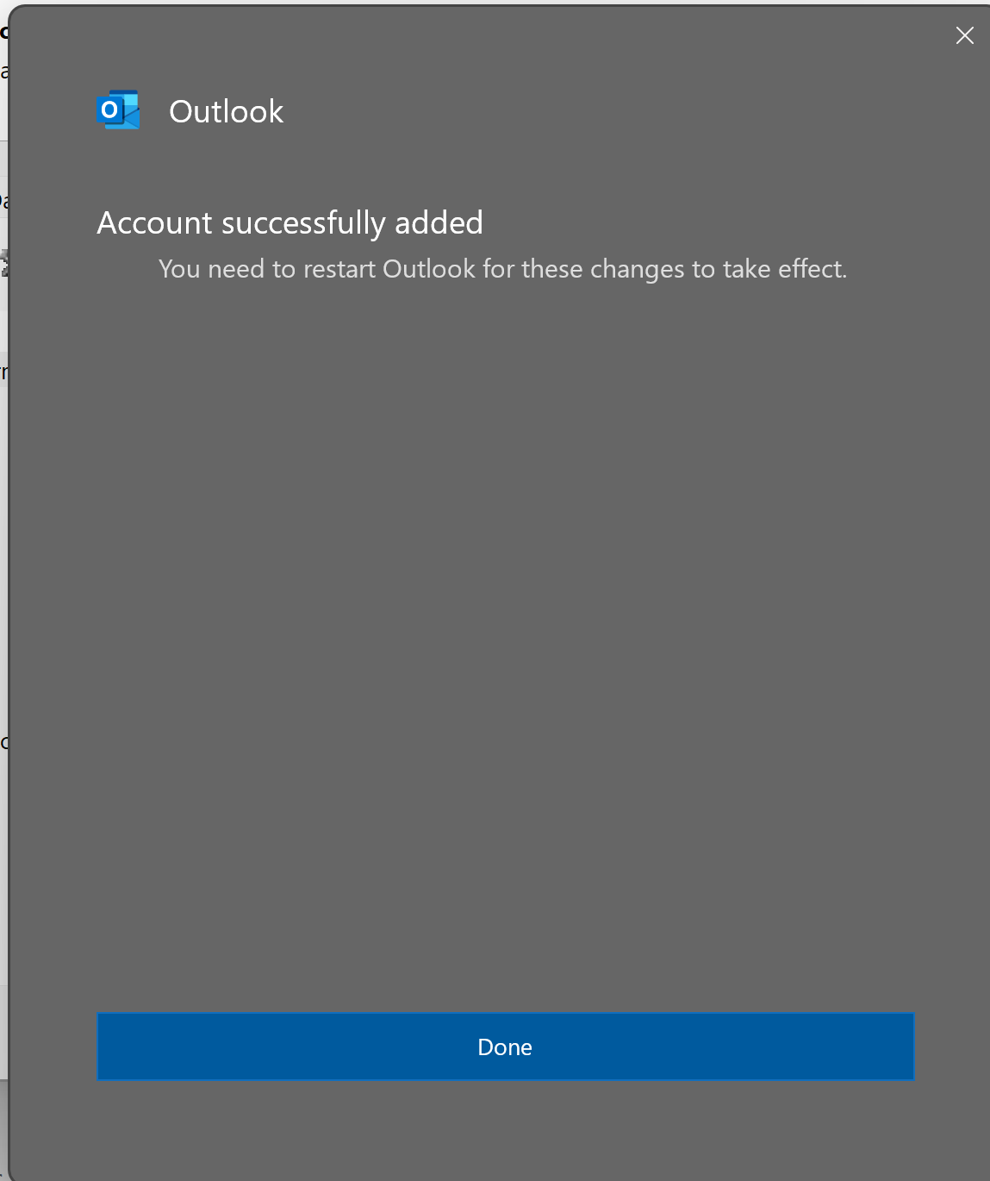
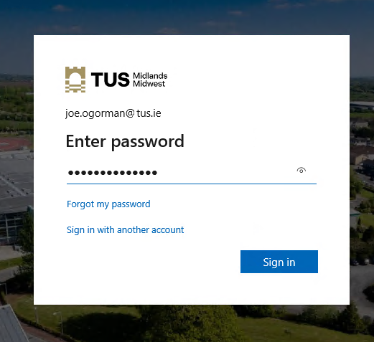
Add your account to your e-mail client

Slide 59
Add your account to your e-mail client

Slide 60
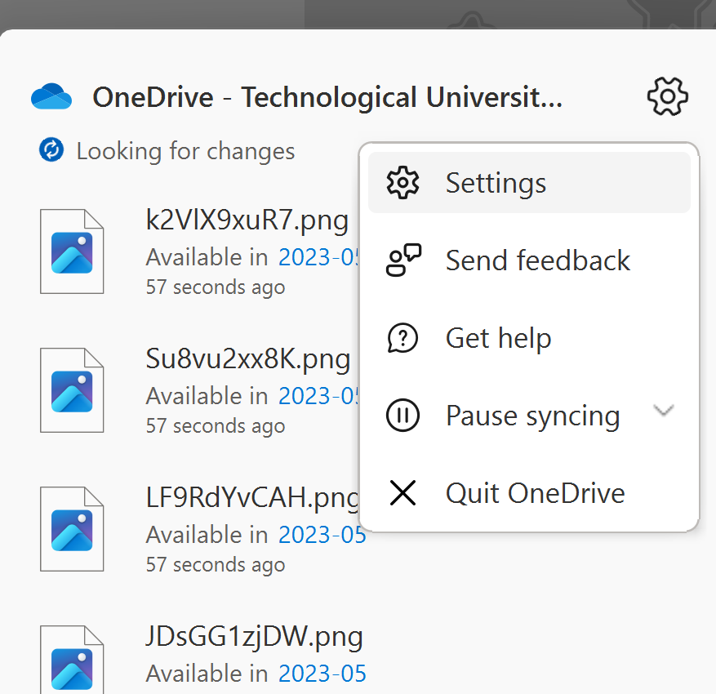
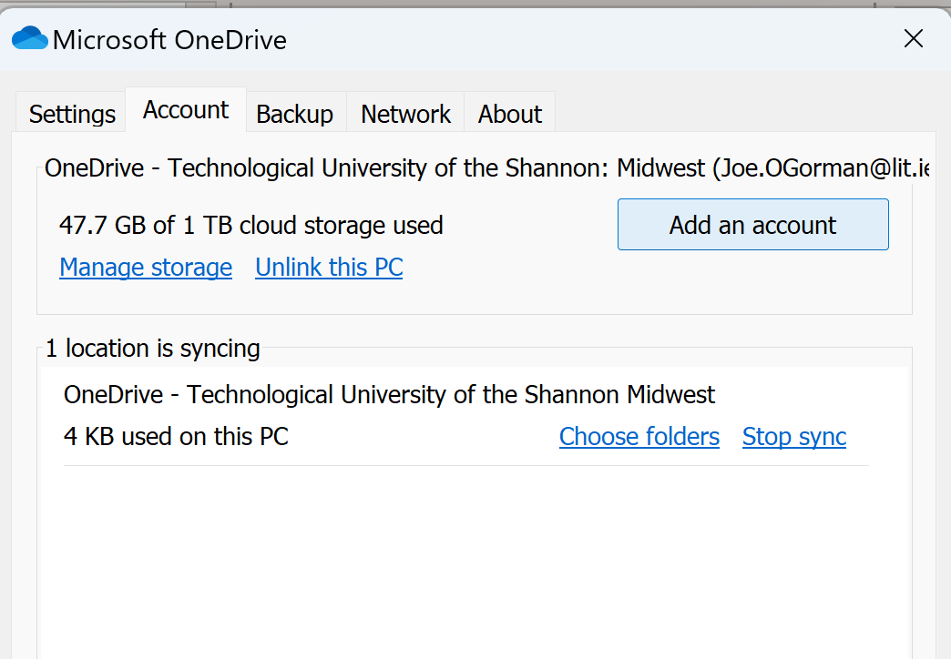
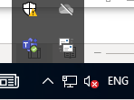
Add your account to OneDrive

Slide 61
Add your account to OneDrive

Slide 62
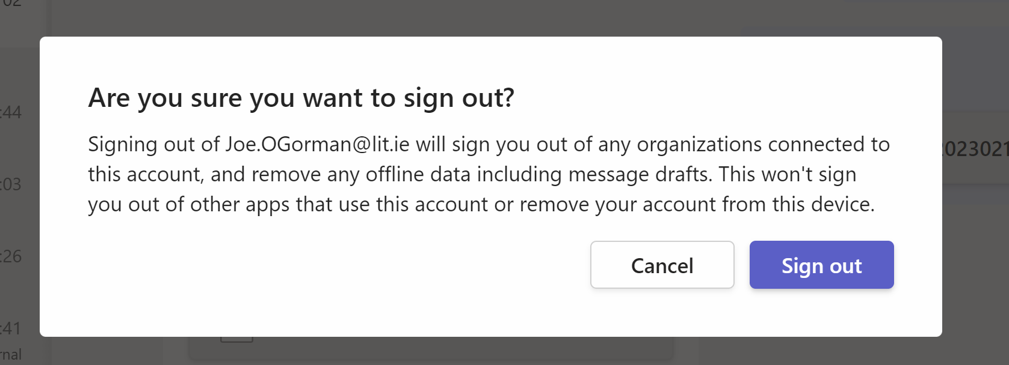
Sign in to Teams

Slide 63
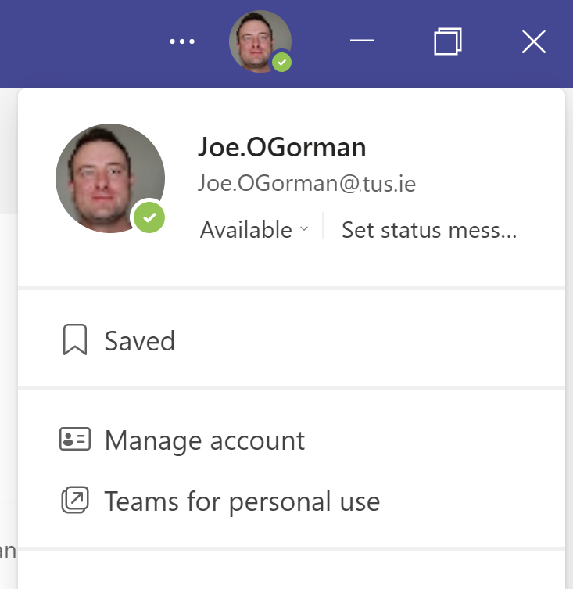
Sign in to Teams

Slide 64
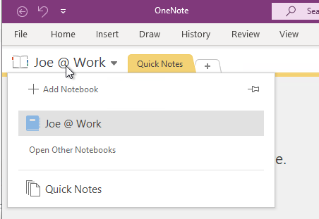
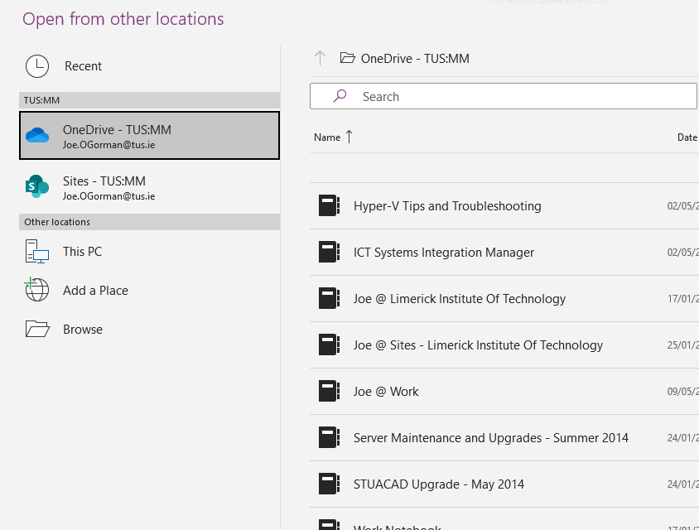
OneNote
OneNote notebooks will have to be re-imported - they are stored on your OneDrive by default

Slide 65
Support

Slide 66
Support
Systems Integration website: https://tus.ie/systems-integration
FAQs on Helpdesk
Helpdesk
There will be dedicated migration support for users and devices at the helpdesk on the Moylish and Athlone campuses
https://helpdesk.ait.ie
https://helpdesk.lit.ie

Slide 67
Library

Slide 68
Library

Slide 69
Q & A

Slide 70
Thank You!

